Slide 1
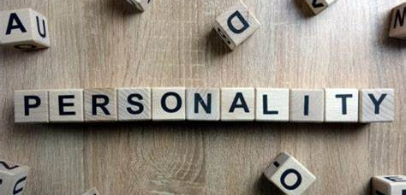

Human Personality Behavior Classification System

Slide 2
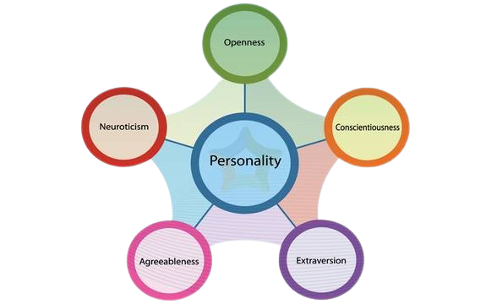
Introduction
Human personality classification is a complex and diverse field that seeks to understand and categorize the various traits, characteristics, and behaviors that make each individual unique. Over the years, psychologists have proposed numerous theories and frameworks to classify personality, each offering different perspectives and insights into human nature.
Myers Briggs Type Indicator (MBTI)
HEXACO Model (Honesty)

Slide 3
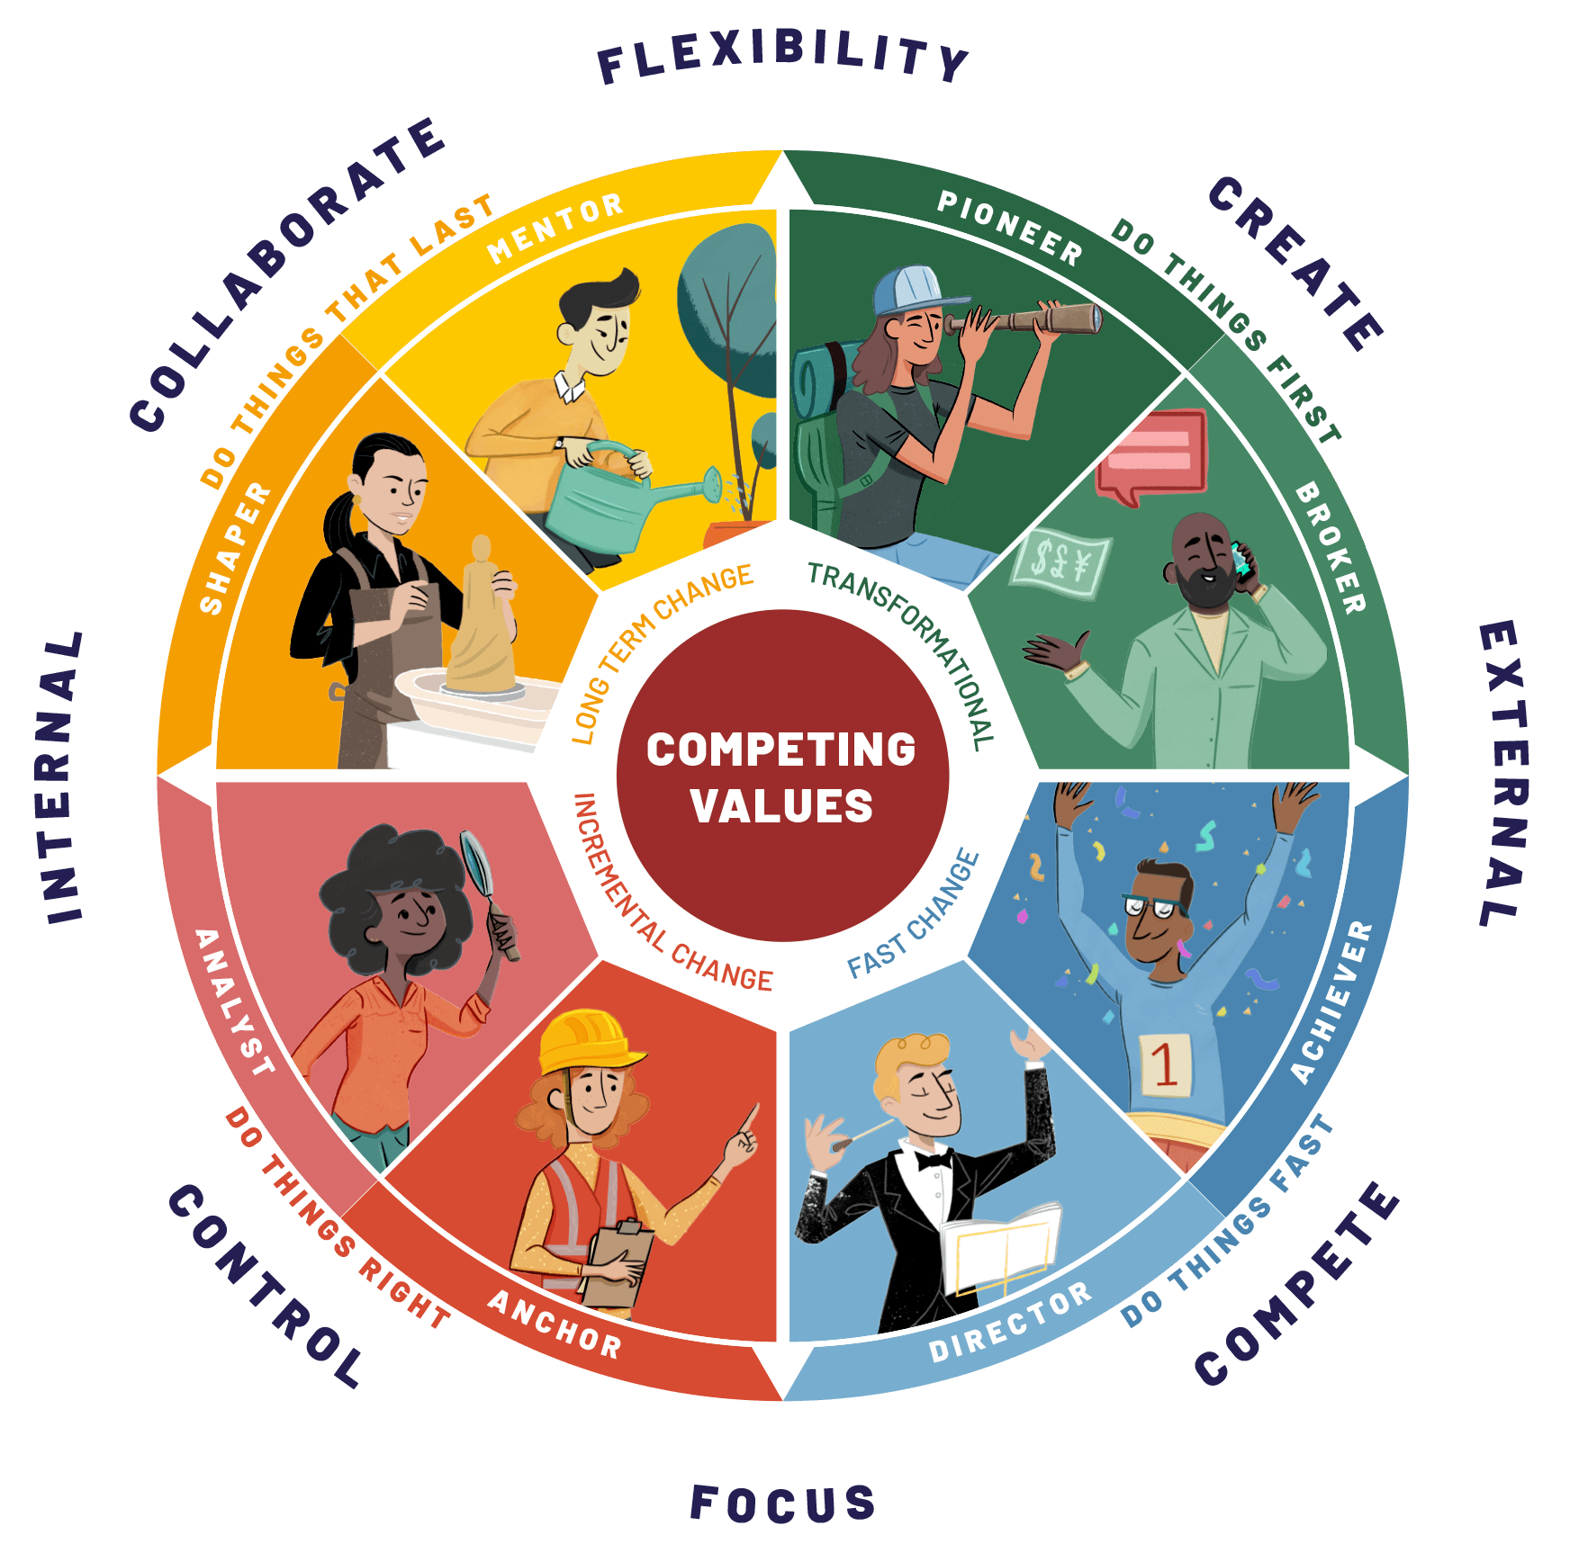
Why to do Personality Classification?
Understanding Self and others: - It helps gain insights about the self, as well as for others.
Predicting Behavior: - It provides a framework for predicting how individuals are likely to behave in different situations.
Career Guidance and Selection: - Many orgs do personality tests as a part of hiring process. For better roles, for job satisfaction and performance.
Therapeutic Interventions: - In clinical and psychology classification is essential for diagnosing the patients, understanding these traits can inform treatment approaches.
Research and Theory Development: - Framework for researchers to study and understand human behavior. Researchers can investigate patterns, correlations, and underlying mechanisms, leading to the development of theories and models that advance our understanding of personality.

Slide 4

Objectives of doing the personality classification?
Develop a Classification Model: The Primary objective is to develop a robust machine learning classification model capable of accurately categorizing individuals into distinct personality types based on a diverse range of behavioural and preference-related features.
Capture Different Aspects of Personality: - To capture the multifaceted nature of personality.
Achieve High Classification Accuracy: - High accuracy between different personality traits ensuring reliable predictions between different personality traits.
Ensure Model Generalization: - We must ensure that our model generalizes well on unseen data. Cross Validation and testing will be helpful.
5. Provide Interpretable Insights: - Understanding which features will contribute most significantly to distinguish between personality traits can offer valuable insights into human psychology and behavior.
6. Contribute to academic knowledge: - This study aims to contribute to academic knowledge by advancing our understanding to human personality behavior.

Slide 5
Data Understanding
File name: - Personality.csv
Based on the Personality Classification.
It has 10000 Rows and 8 Columns in it.
Movie Preference: - Genre of movie which the user regularly watches.
Social Media Activity: - Describes what the user regularly like to watch on social media platforms.
Reading Habits: - Describes that what user likes to read most of the time.
Favorite Leisure Activities: - Describes what user likes to do in the free time.
Music Taste: - Describes what type of music user likes to listen most of the time.
Fashion Style: - Describes what user likes to wear most of the time.
Travel Preferences: - Describes which type of place user likes to visit.’
Personality Behavior: - Describes which type of personality does the user possess based on the features mentioned above.

Slide 6
Univariate Analysis
Movie Preferences: - Mystery 25.2%,
Action 25%,
Comedy 25%,
Science Fiction 24.8%
Social Media Activity: - Games 9.9%,
Food 10.5 %,
Fitness 20.5%,
Lifestyle 29.5%,
Fashion 29.6%
Reading Habits: - Novels 19.5%,
Short Stories 39.1%,
Comics 41.4%
Favorite Leisure Activities: - Gaming 19.1%,
Reading 20.7%,
Drawing 29.9%,
Sports 30.2%
Music Taste: - Jazz 24.4%,
Classical 24.8%,
Rap 25.2%,
EDM 25.7%
Fashion Style: - Classic 19.6%,
Sporty 20.0%,
Casual 29.8%,
Vintage 30.6%
Travel Preferences: - Adventure 20.1%,
Family Holidays 20.2%,
Road Trips 29.8%,
Solo Travel 29.9%

Slide 7
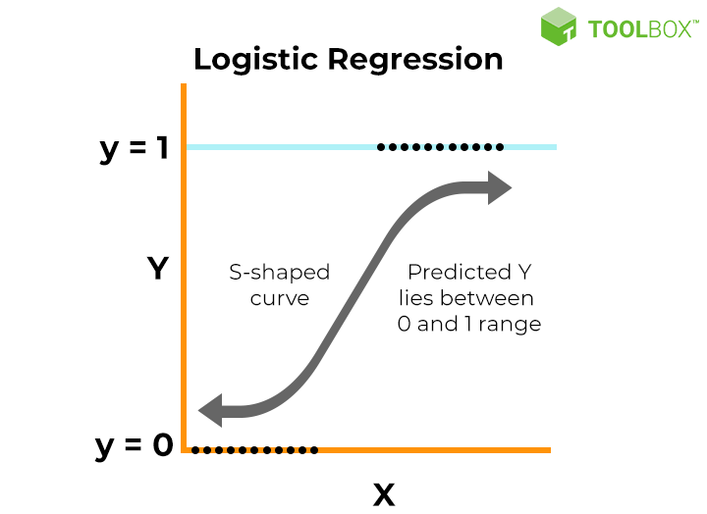
Logistic Regression
Process of modelling the probability of a discrete outcome given an input variable.
It gives the probability as an output.
Most common Logistic Regression models a binary outcome.
Our dataset also we have 2 outcomes in the dependent variable i.e, Complex and Versatile.
We have used Logistic Classifier as we have only Categorical Features into it.
Logistic_classifier.predict(X_test) for classification of the testing data points.
Accuracy is: - 50.2%
F1 Score is: - 52.2%
Precision score is: - 57.9%
Recall Score is: - 50.2%

Slide 8
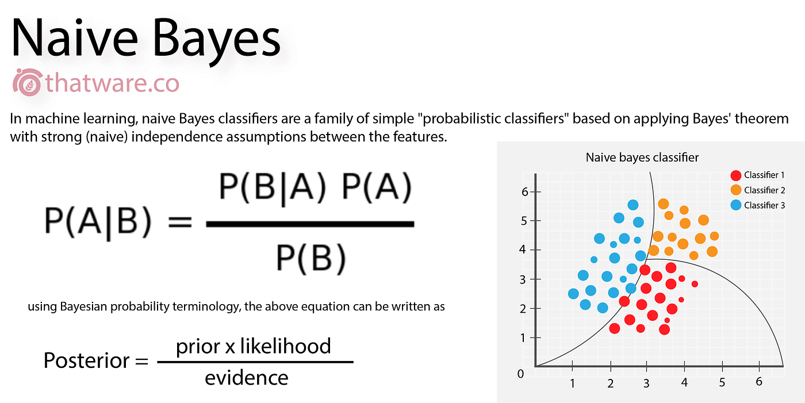
Naive Bayes
It is used for text classification.
Probabilistic Classifier.
Uses Conditional Probability and Determination of Likelihood.
Uses Bayes Theorem to calculate the Posterior Probability.
Assumes that all the predictor variables are independent of each other.
Here I have used Multinomial Naive Bayes Classifier although we have only two outcomes.
Used for discrete counts, here we have count how often words occurs in the document.
MultinomialNB() is used for model Initialization.
Model.predict(X_test) is used for classification of the testing data points.
Accuracy is: - 70.35%
F1 Score is: - 52.2%
Precision score is: - 49.4%
Recall Score is: - 100%

Slide 9
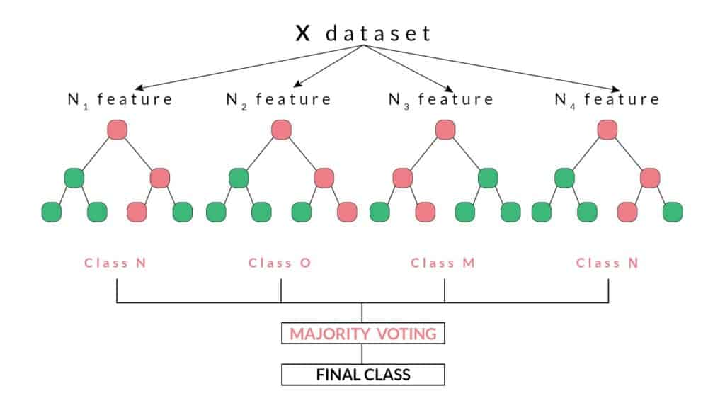
Random Forest Classification
Supervised machine learning algorithm, there should available a labelled dataset.
Can be used for both regression as well as classification.
Ensemble method, means it can combine predictions from other models.
Each of the smaller model in this model is a decision tree.
This model in my dataset will make multiple decision trees and all the decision trees can say that whether the testing data points classified is Complex or Versatile.
Here I have used Random Forest Classifier and we have only two outcomes.
RandomForestClassifier() is used for model Initialization.
Model.predict(X_test) is used for classification of the testing data points.
Accuracy is: - 63.9%
F1 Score is: - 59.66%%
Precision score is: - 57.84%
Recall Score is: - 63.82%

Slide 10
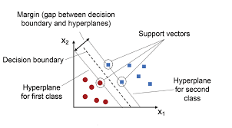
Support Vector Machine
Supervised machine learning algorithm.
Can analyze data used for regression and classification analysis.
Given a training data, the algorithm outputs an optimal hyperplane which categorizes new examples.
Representation of examples as points in space, mapped so that the separate categories are divided by a clear gap as wide as possible.
Can efficiently perform on non-linear classification.
Here I have used Support Vector Machine Classifier, kernel is linear.
Svm.SVC() is used for model Initialization.
Model.predict(X_test) is used for classification of the testing data points.
Accuracy is: - 70.66%
F1 Score is: - 82.81%
Precision score is: - 70.66%
Recall Score is: - 100%

Slide 11
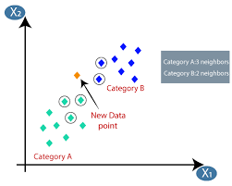
K Nearest Neighbor
Supervised machine learning algorithm for regression and classification.
Belongs to supervised domain and finds intense application in pattern recognition.
It is simple, basic, non-parametric, it does not take any underlying assumptions about the distribution of data.
We are given some training data, which classifies coordinates into groups identified by an attribute.
Here I have used K Nearest Neighbors Classifier, n_neighbors = 35.
KNeigborsClassifier() is used for model Initialization.
Model.predict(X_test) is used for classification of the testing data points.
Accuracy is: - 69.40%
F1 Score is: - 81.89%
Precision score is: - 69.5%
Recall Score is: - 100%

Slide 12
Conclusion
In conclusion, this study represents a significant step towards understanding the multifaceted nature of human personality behavior through a comprehensive analysis of diverse features and preferences. By developing a robust classification model capable of distinguishing between different personality traits, we have uncovered valuable insights into the underlying dynamics of human psychology and behavior.
Through meticulous data collection, feature engineering, and model development, we have demonstrated the feasibility of capturing the complexities of personality behavior using machine learning techniques. Our model achieves high classification accuracy, providing reliable predictions that reflect the nuances of individual preferences and tendencies.
Furthermore, our study highlights the importance of considering multiple dimensions of human behavior in understanding personality traits. By integrating insights from various domains such as entertainment preferences, social media activity, leisure activities, and travel preferences, we have gained a holistic perspective on human personality behavior.
In conclusion, this study underscores the richness and complexity of human personality behavior and the potential of machine learning to uncover valuable insights in this domain. By continuing to explore and refine our understanding of personality traits, we can deepen our appreciation of what makes each individual unique and contribute to a more nuanced understanding of human psychology and behavior.

